Slide 1
Series Circuit Analysis

Slide 2
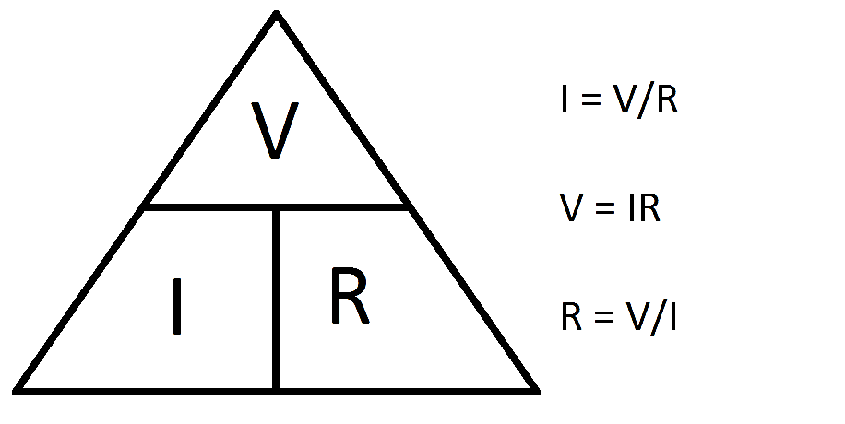
Ohm’s Law Formula
There are three form of Ohm’s Law :
Where :
I = Current
V= Voltage
R= Resistance

Slide 3
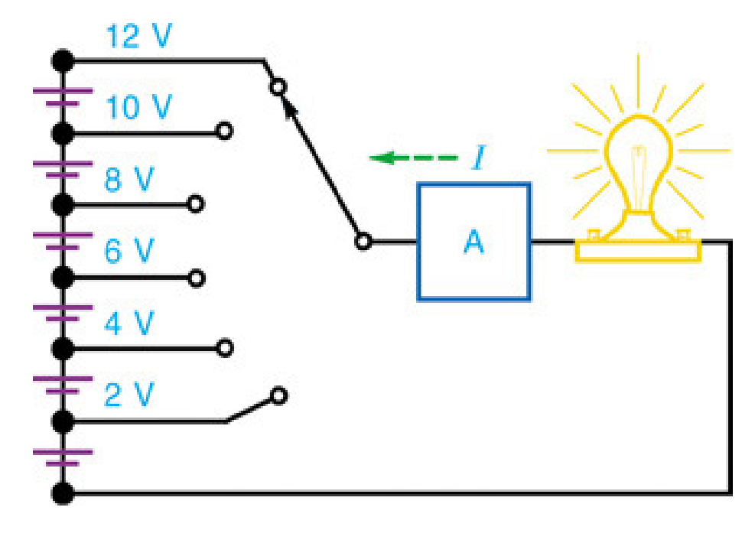
12/3 = 4
10/3= 3.3 A
8/3= 2.6 A
6/3= 2 A
4/3= 1.33 A
2/3= 0.6 A
I= V/R

Slide 4
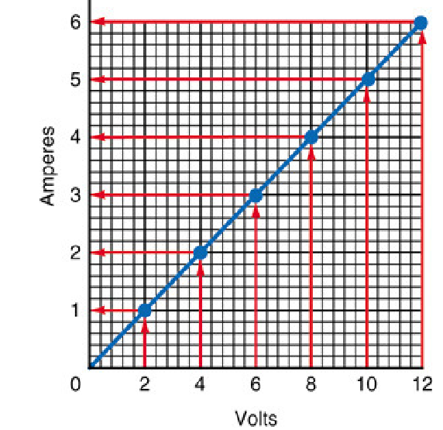

Slide 5

Problem 1
Calculate the voltage if the current is 0.5 A and the resistance is 2.0 Ohms.
R1
2.0 Ω
V = ?
I = 0.5
R= 2.0 ohms
V= I*R 0.5*2.0 = 1 Volt

Slide 6
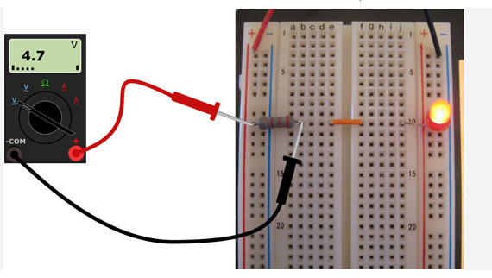

Slide 7
Problem 2
Calculate the Current if the voltage is 1.2 V and resistance is 0.6 Ω
R1
0.6 Ω
V = 1.2
V= 1.2
R= 0.6 ohms
I = 1.2/0.6 = 2 A

Slide 8
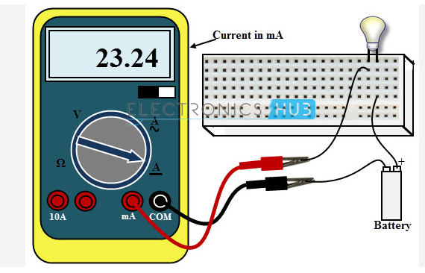

Slide 9
Problem 3
Calculate the resistance if the current is 1.1. and the voltage is 2.2 volt.
R1
?
V 2.2
V= 2.2
I = 1.1
R= 2.2/1.1 = 2 ohms

Slide 10
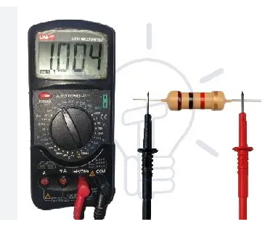

Slide 11
Problem 4
Solve for the resistance , R when V and I are given
V= 14V , I= 2A R= ?
V= 25V , I= 5A R= ?
V= 6V , I= 1.5A R= ?
V= 24V , I= 4A R= ?
7 Ω
5 Ω
4 Ω
6 Ω

Slide 12
Problem 5
Find the Total Voltage as V_{T} and Total Current I_{T}
R1
3 Ω
R2
3 Ω
12V
R3
3 Ω
Total voltage = 12 V
Total Resistance= 9 Ω
Total Current = V/I 12/9 = 1.3 A

Slide 13
Find the following in given circuit.
V1
V2
V3
V_{T}
R1
R2
R3
R_{T}
I1
I2
I3
I_{T}
R1
15 Ω
R2
5 Ω
120 V
R3
20 Ω
V1 = 45V
V2 = 15 V
V3 = 60 V
V_{T} = 120 V
R1= 15 Ω
R2 = 5 Ω
R3 = 20 Ω
R_{T} = 40 Ω
I1 = 3 A
I2 = 3 A
I3 = 3 A
_{IT} = 3 A

Slide 14
Find the following in given circuit.
V1
V2
V3
V_{T}
R1
R2
R3
R_{T}
I1
I2
I3
I_{T}
R1
17 Ω
R2
12 Ω
60 V
R3
11 Ω
V1 = 25.5V
V2 = 18 V
V3 = 16.5 V
V_{T} = 60 V
R1= 17 Ω
R2 = 12 Ω
R3 = 11 Ω
R_{T} = 40 Ω
I1 = 1.5 A
I2 = 1.5 A
I3 = 1.5 A
I_{T} = 1.5 A

